Slide 1
Cotswold
Gateways

Slide 2
Cotswold
Gateways
Growth Tourism Call What it wants
Economic development
Capital – no staff
Support jobs
£35k+

Slide 3
Growth Tourism Call - What it wants
Fit with National Programme and Local Enterprise Partnership (LEP) Priorities
The aim is to support projects that will encourage more tourists to come, to stay longer and to spend more money in rural areas. (Nat)
Increase visitor numbers, particularly the off-peak season between October and March, leading to more overnight stays. (OxLEP)
Create infrastructure to develop outdoor activities particularly walking and cycling for both the Forest of Dean and Cotswold areas. (GFirst)

Slide 5
Project Proposal
AONB wide - 3 LEP areas, Gloucestershire, Oxfordshire & West of England
Cycle links – gap in the Cotswolds network
Gateways (Boards) with improved walking/cycling routes running out from them
Away from honeypots
Linked to public transport
Wanted by the local communities/businesses
Welcoming & accessible – broaden engagement
On line and physical interpretation
Discovered when out there
Map/Interpretation Boards/way marking at Gateways
Hard copy routes in gateway communities – businesses/shops/centres/accommodation
Researched
Downloadable routes PDF/GPX
Routes uploaded to commonly used GPS phone apps – Viewranger, Outdoors & Ordnance Survey

Slide 6
Method & Milestones
26th May 2017 – Expression of Interest Submitted
27th June – Expression of Interest Successful
July – early November - Contacted selected long list of Parish & Town Councils & worked up detailed proposals with the partners that responded.
November - Quotes based on detailed proposals & Bid written
30th November – Bid submitted on the deadline

Slide 7
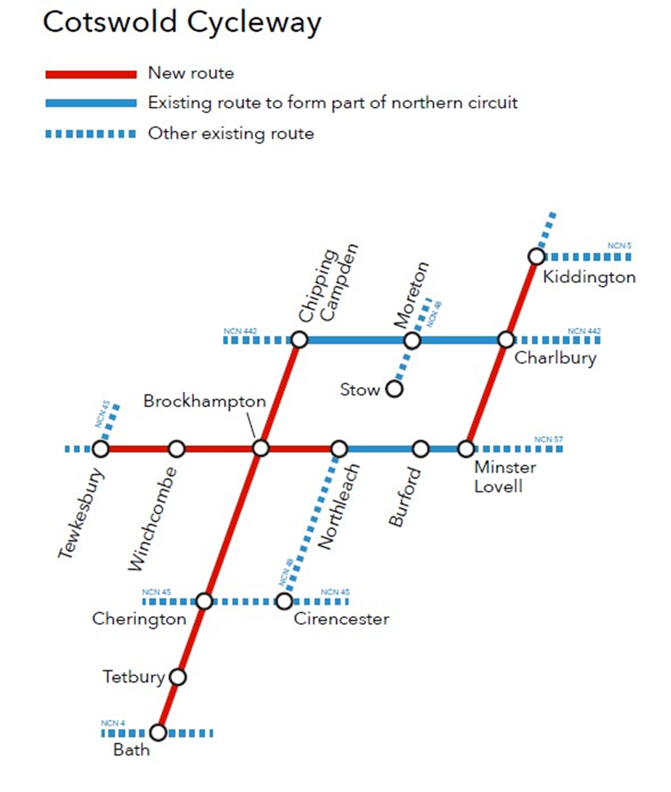
Where

Slide 8
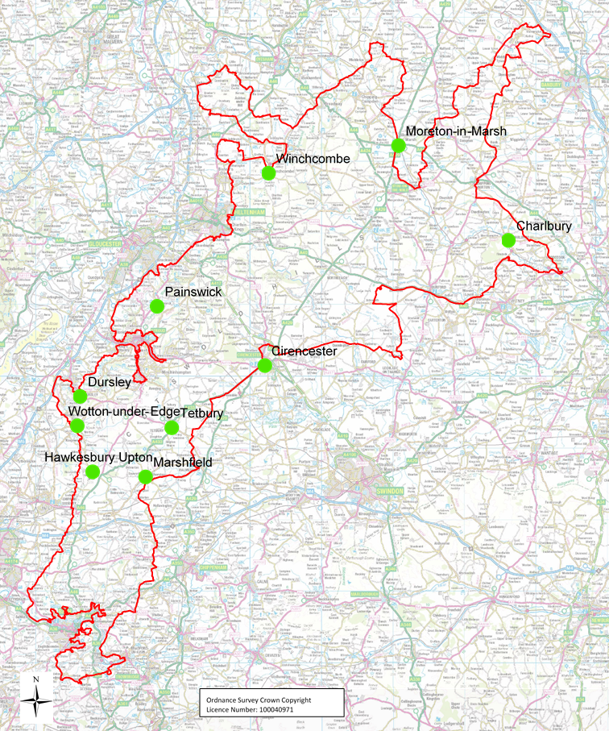
Where
Gateway Map
Charlbury 2 walking routes
Cirencester 1 multi use cycling route
Dursley 2 walking routes
Hawkesbury Upton 2 walking routes
Marshfield 4 walking routes
Moreton in Marsh 2 walking routes
Painswick 2 walking routes
Tetbury 1 walking route
Wotton under Edge 4 walking routes and 3 cycling routes
Winchcombe 6 walking routes and 3 cycling routes

Slide 9
Where
Gateway Map
Charlbury 2 walking routes
Cirencester 1 multi use cycling route
Dursley 2 walking routes
Hawkesbury Upton 2 walking routes
Marshfield 4 walking routes
Moreton in Marsh 2 walking routes
Painswick 2 walking routes
Tetbury 1 walking route
Wotton under Edge 4 walking routes and 3 cycling routes
Winchcombe 6 walking routes and 3 cycling routes
Circular path
7 radial routes

Slide 10
What
26 walking routes = 130 miles.
7 (Gateway) + 3 (cross Cotswolds) cycle routes = 180 miles
73 waymarking posts
884 waymarking signs on existing street furniture
29 kissing gates
9 surface improvement sites
£66k
Practical delivery – volunteer groups Inc. Cycle and Walking groups & Voluntary wardens

Slide 11
Next Steps
30th March 2018 Project starts (fingers crossed)
28th September 2018 Interpretation design complete
28th June 2019 Route improvements & way marking completed
30th August 2019 Boards & all Interpretative materials in place (real world & on-line)
5th October 2019 Programme launch

